Slide 1


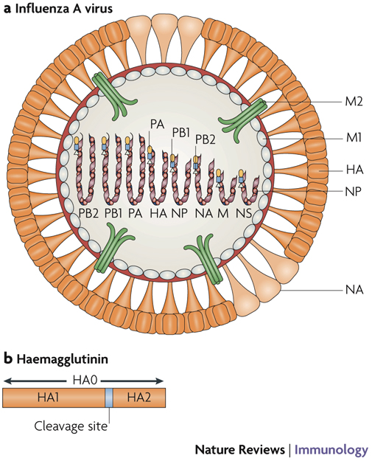
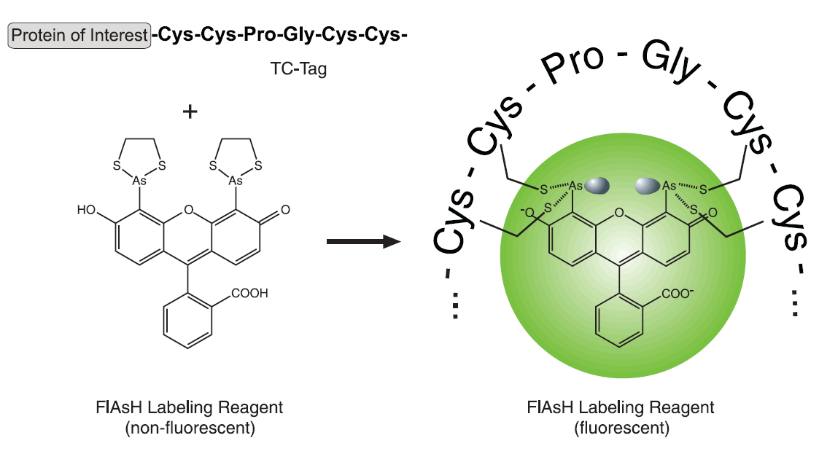
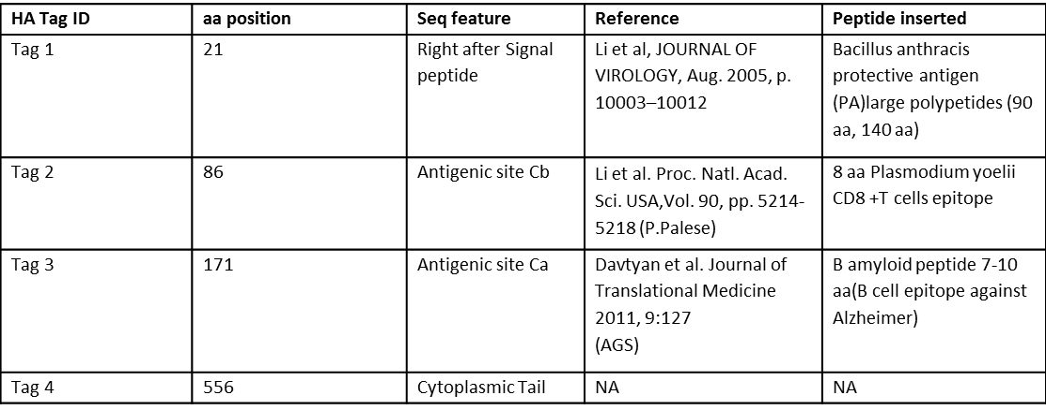
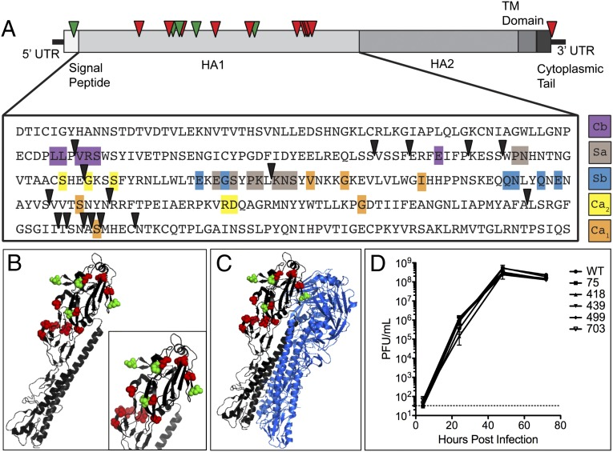
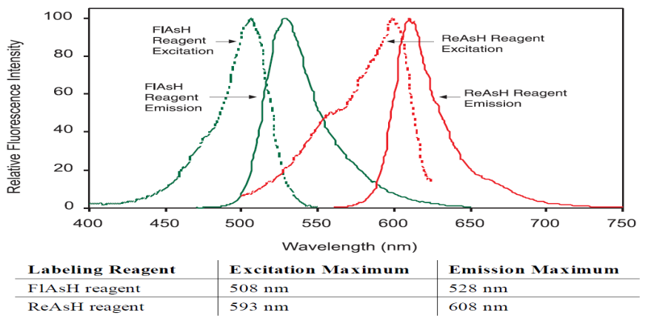
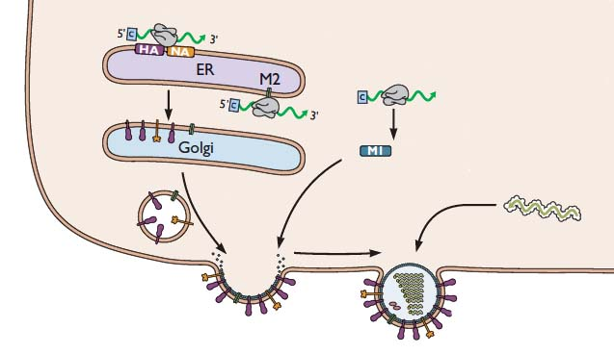
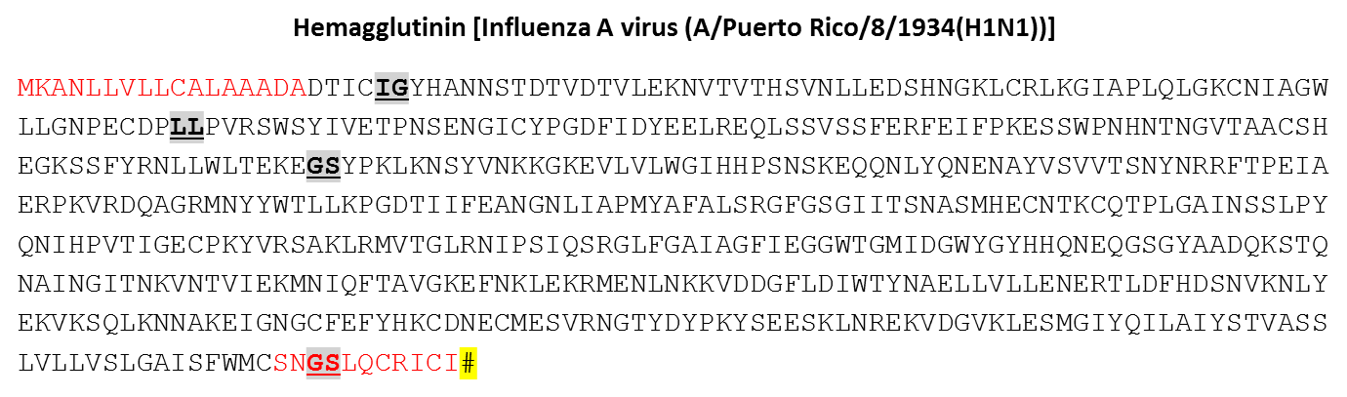
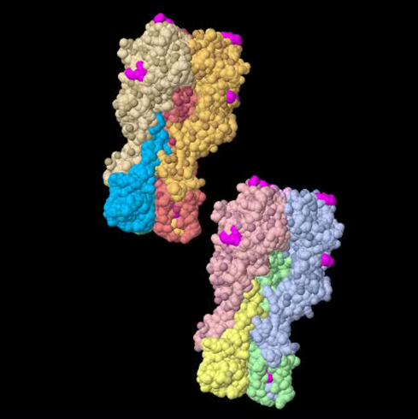
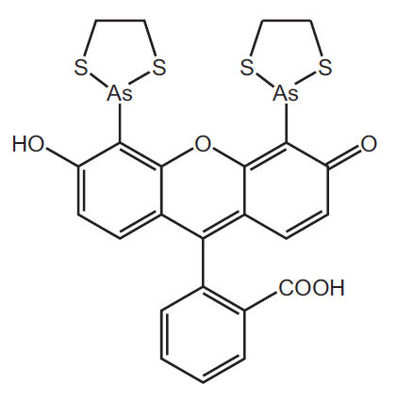
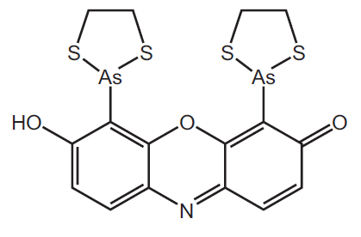


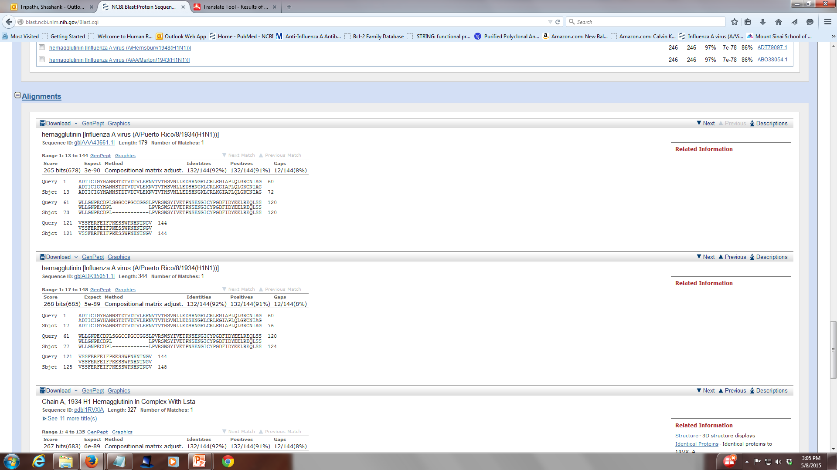
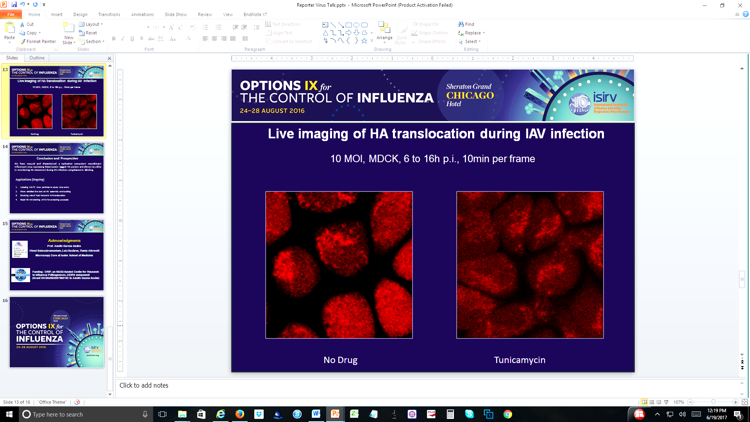

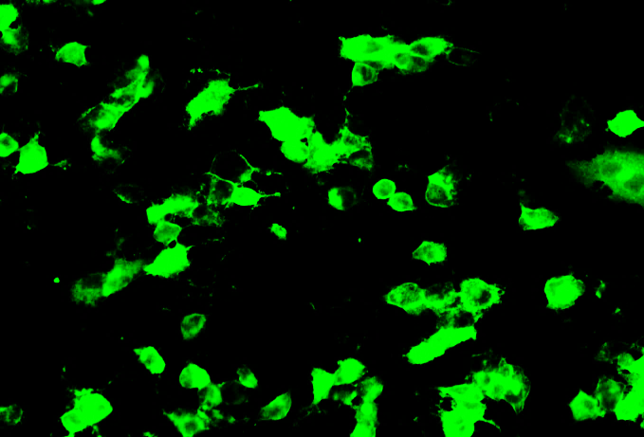
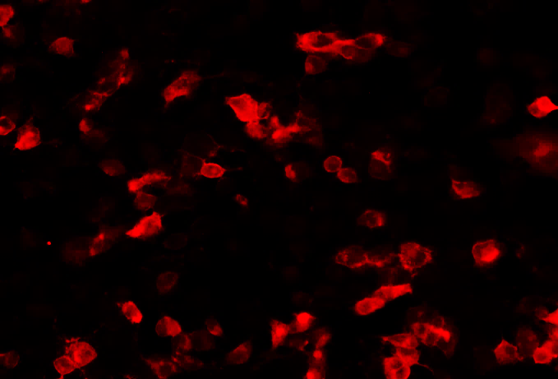
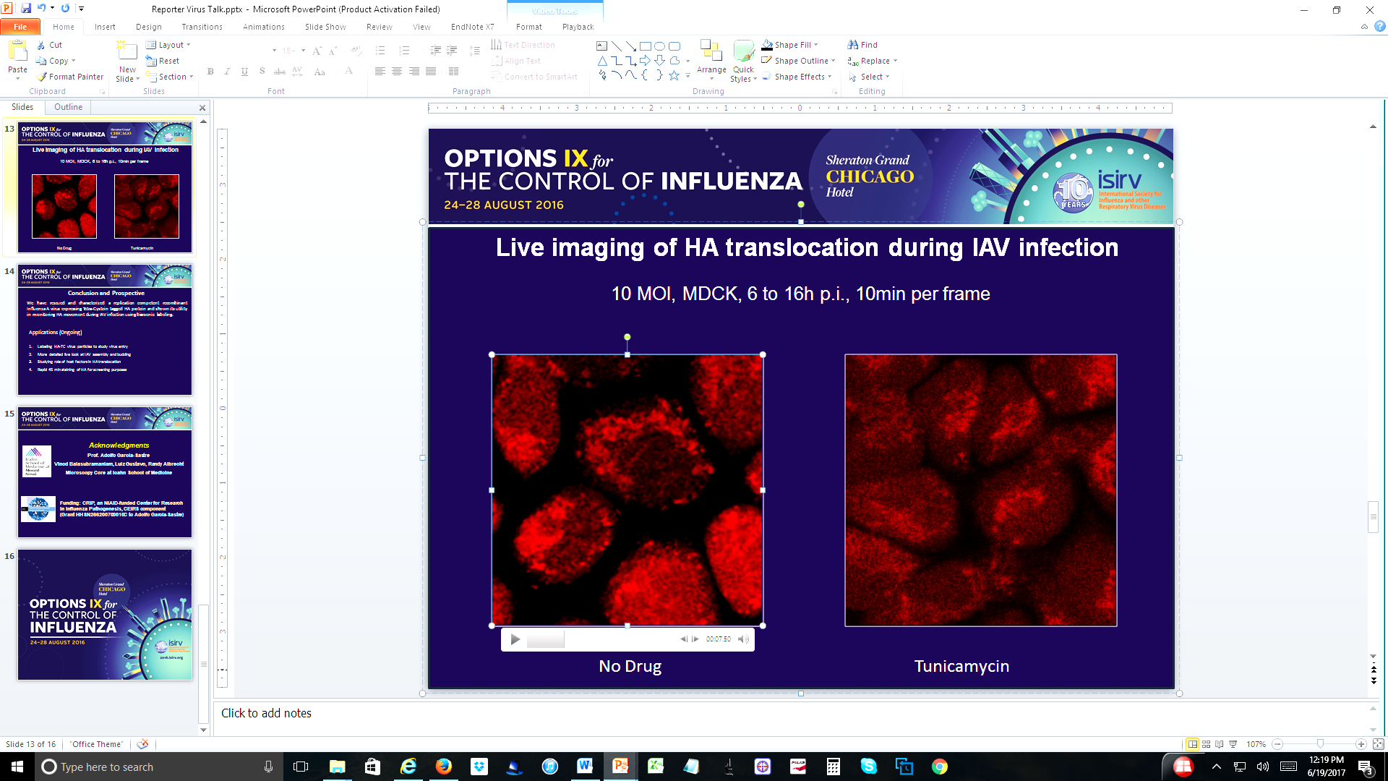
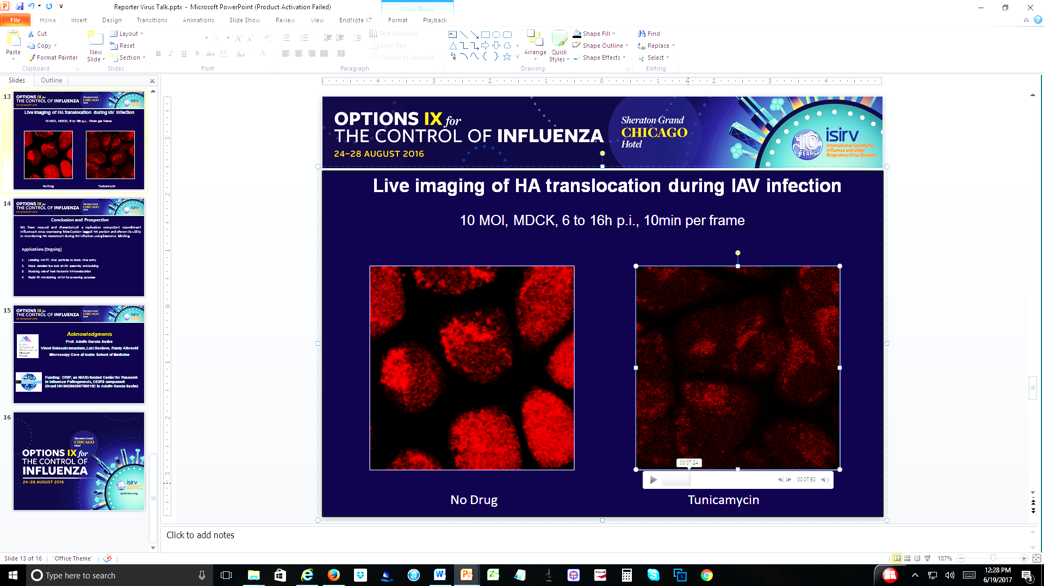
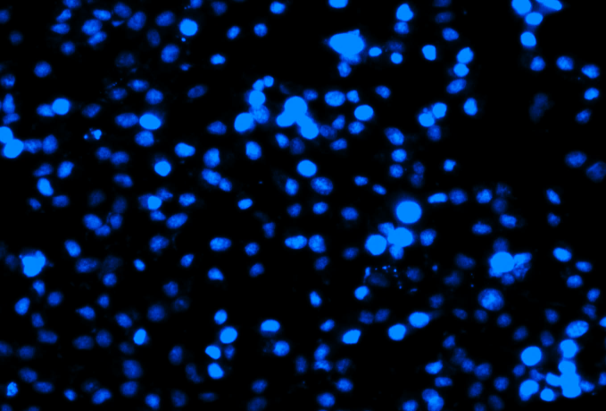
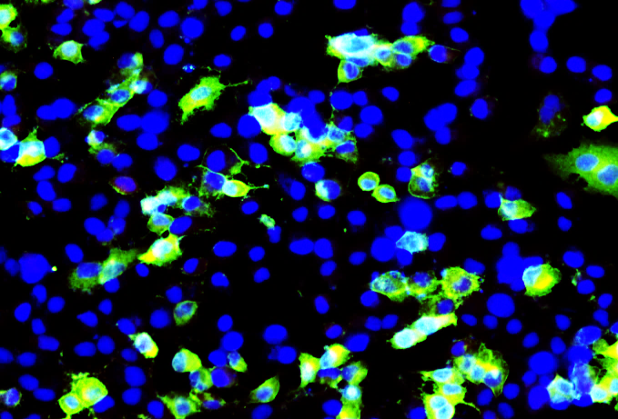
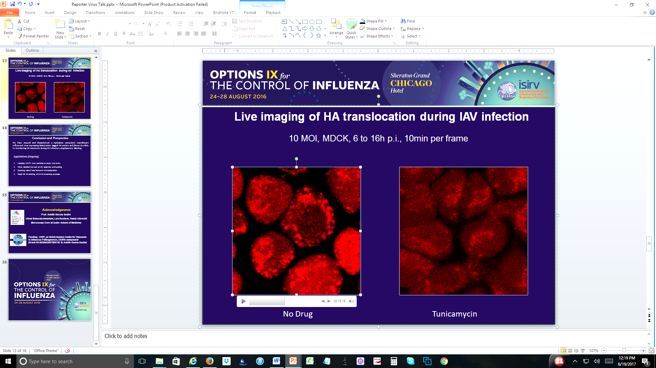

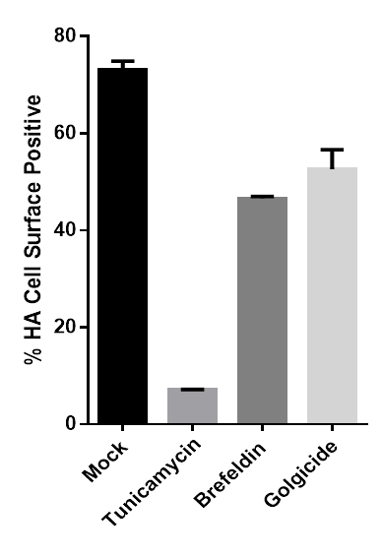
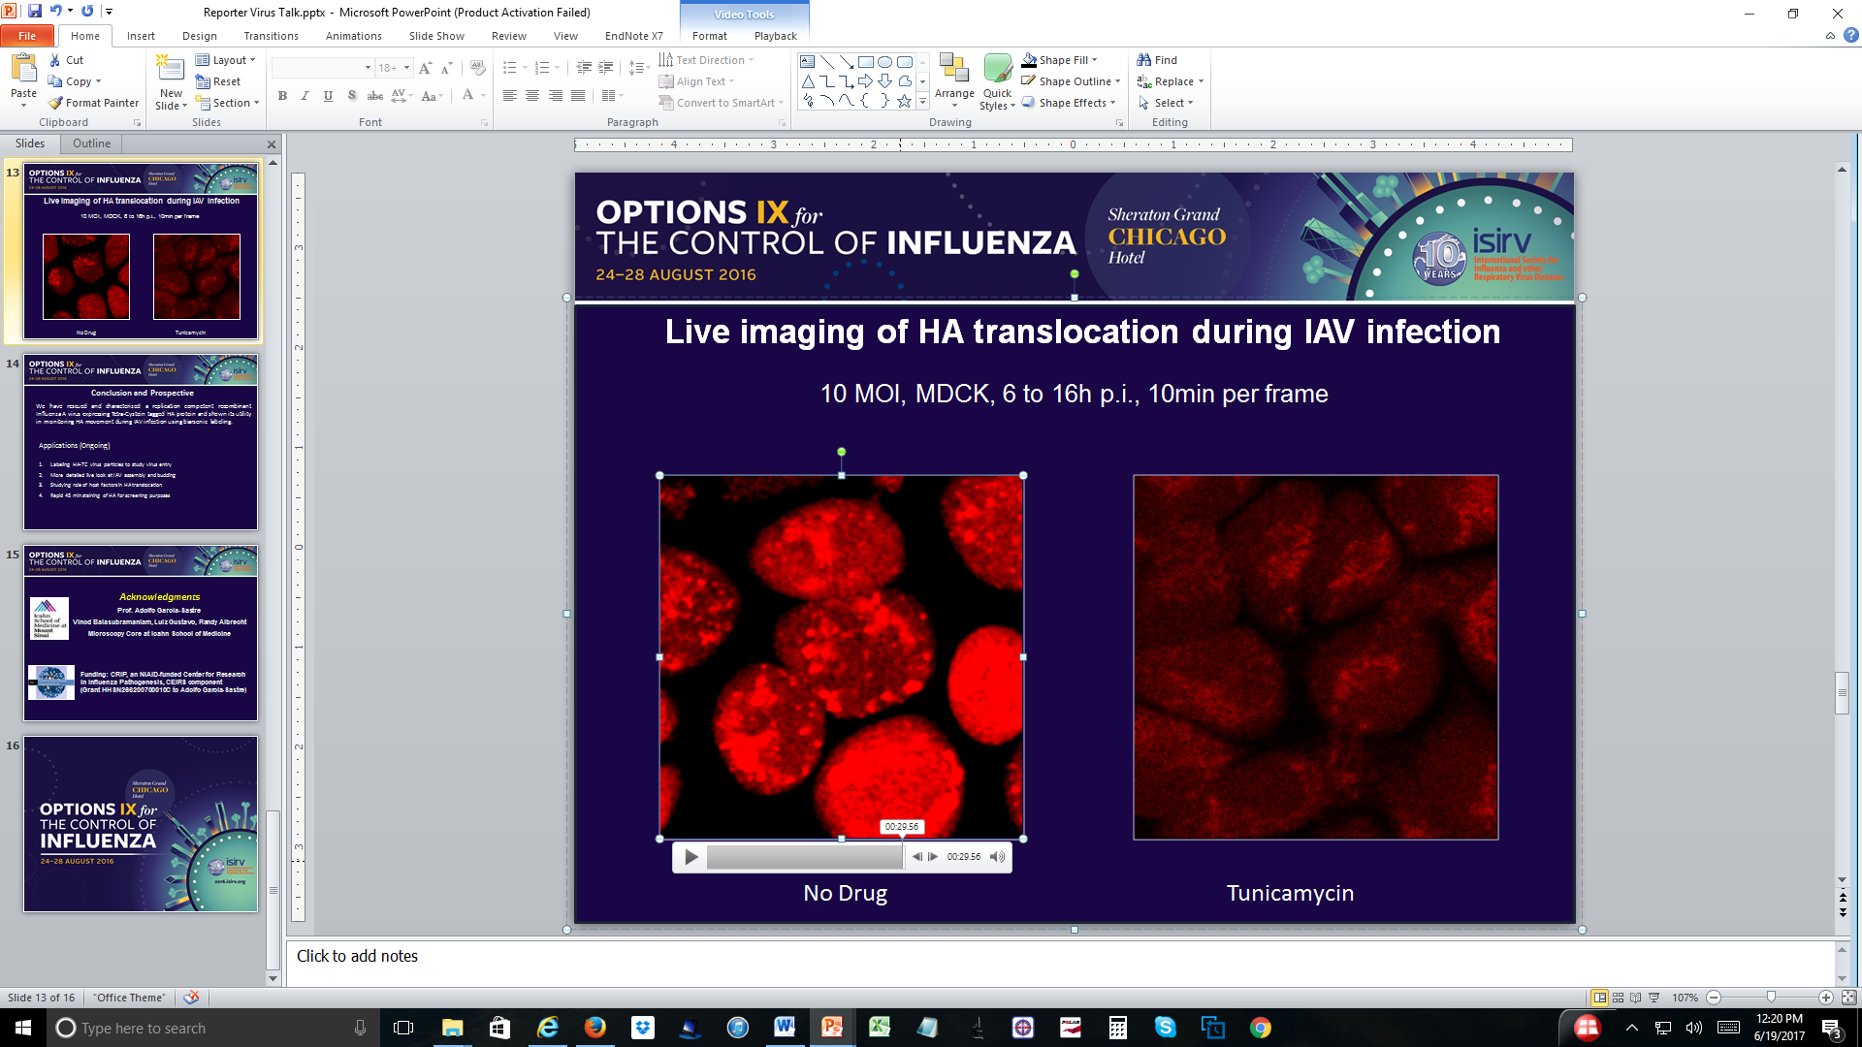

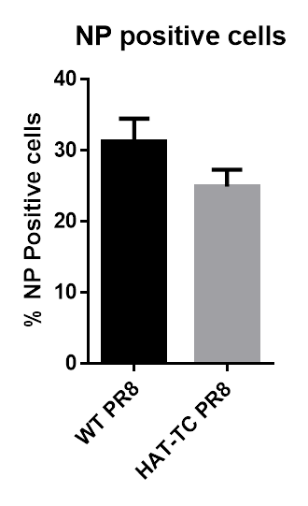
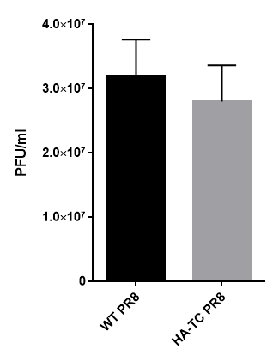
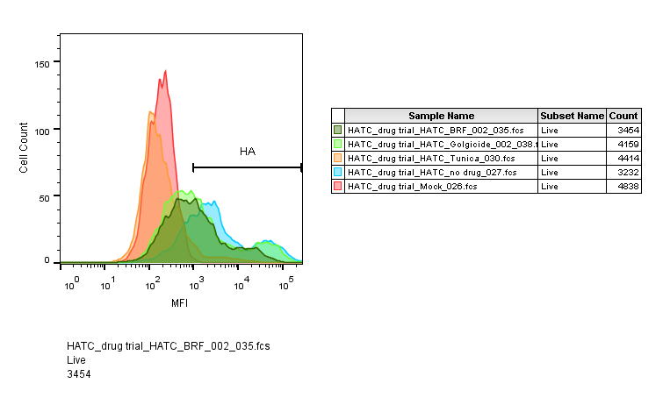
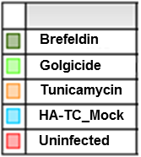
Live visualization of hemagglutinin dynamics during infection by using biarsenically labeled replication competent Influenza A virus
Shashank Tripathi^{1,2}, Luiz Gustavo dos Anjos Borges^{1,2}, Giuseppe Pisanelli^{1,2}, Randy A. Albrecht^{1,2}, Adolfo García-Sastre^{1,2,3},
¹Department of Microbiology, Icahn School of Medicine at Mount Sinai, New York, NY, USA
²Global Health and Emerging Pathogens Institute, Icahn School of Medicine at Mount Sinai, New York, NY, USA
³Department of Medicine, Division of Infectious Diseases, Icahn School of Medicine at Mount Sinai, New York, NY, USA
SUMMARY
Background: Live visualization of influenza A virus (IAV) structural proteins during the course of viral infection in cells is a much desired objective.
Method: To achieve this we engineered an IAV hemagglutinin (HA) segment (subtype H1) to express a Tetra Cysteine tag (TC tag), which allows intracellular labeling of the engineered protein with biarsenic dyes and subsequent fluorescence detection. We chose four different permissive sites in the HA segment for insertion of the tag sequence, and confirmed the expression and specific biarsenic labeling of the TC-tagged HA proteins. Next we tested the ability of the engineered HA proteins to form virus like particles (VLP). We could detect VLP formation by two TC-tagged HA proteins as evidenced by release of hemagglutinating particles from HA overexpressing cells that was comparable to that of wild type HA. Finally we tried to rescue replication competent influenza A virus expressing a TC tagged HA.
Results: We could rescue one recombinant virus with TC tag inserted in antigenic site b of HA, in A/Puerto Rico/8/1934(H1N1) background. This virus replicated an order of magnitude lower than the wild type virus in MDCK cells. We confirmed expression and biarsenic labelling of HA by immunofluorescence assay in cells infected with an HA-TC tag reporter IAV, but not in cells infected with wild-type IAV. Further, we have used this reporter virus to visualize HA expression and movement in IAV infected cells by live cell imaging. Also, biarsenically labelled virus particles were used to visualize virus entry. We are currently using this tool to study effects of host factor perturbations on HA movement during virus entry, assembly and budding.
Conclusion: This reporter virus is a versatile tool for studying viral life cycle events, virus-host interactions and anti-influenza drug screening.
Influenza Virion
Tetra Cysteine Tag: how it works
Site selection for Tag insertion
Tag 1
Tag 2
Tag 3
Tag 4
Kanta Subbarao & Tomy Joseph,
Nature Reviews Immunology 7, 267-278
Science. 1998 Jul 10;281(5374):269-72. Griffin BA1, Adams SR, Tsien RY.
FlAsH
ReAsH
Transport of IAV proteins to budding site
Rescue and Characterization of PR8 HA-TC IAV
Biarsenic labeling of HA in HA-TC IAV infected cells
Live imaging of HA translocation during IAV infection
anti HA Ab
ReAsh Dye
4h
8h
DAPI
Merge
8h
8h
0.1 MOI, MDCK cells
0.1 MOI, MDCK, 24h p.i.
12h
Comparison of WT PR8 and HA-TC PR8 viruses
Drug mediated Inhibition of HA transport
16h
WT PR8
Mock
Tunicamycin
10 MOI, MDCK, 4 to 16h p.i., 10min per frame
HA-TC PR8
Acknowledgements
Funding: CRIP, an NIAID-funded Center for Research in Influenza Pathogenesis, CEIRS component (Grant HHSN266200700010C to Adolfo García-Sastre)
Microscopy Core at Icahn School of Medicine
5 MOI, MDCK, 4h p.i.
5 MOI, MDCK, 16h p.i.
5 MOI, 16h p. i.
Drug @ 6h p.i.
Tunicamycin (2 µM)
Brefeldin A (5 µg/ml)
Golgicide (100 µM)
Virus Entry
Virus Release

